Slide 1
Operating Systems (2015R Regulation)
UNIT – 1 Introduction
Introduction: What Operating System Do – Operating System Structure – Operating system Operations – Operating System Components
Classes of Operating Systems: Mainframe Systems – Single Processor System - Multiprocessor Systems - Desktop Systems –– Distributed Systems – Clustered Systems – Real-Time Systems – Handheld Systems - Open Source Operating Systems.
Operating System Structures: Operating System Services – User and Operating System Interface – System Calls – Types of System Calls.

Slide 2
Operating Systems (2015R Regulation)
What is mean by Software:
Software is any set of instructions that directs a computer to perform specific operations.
Categories of software :
Application S/W | System S/W | Developer S/W
Business | Boot loader | Compilers
Financial | Device driver | S/W development tools
Communication | Firmware | S/W testing tools
Editing | Graphical user interface | Web development tools
Entertainment | Operating system
Simulation
Personal information manager

Slide 3
Operating Systems (2015R Regulation)
Fundamentals of Computer System
Users
Application programs and System Programs
Operating systems
Hardware
User:
A person who uses computers for work or entertainment or communication or business etc..
Application program and System programs:
Application program is designed to help people perform an activity.
Ex: Web browser, Compiler, Word processing, Media players etc...
Systems program consists of low-level programs that interact with the computer hardware.
Ex: Device drivers, Operating system etc..
Operating system:
An operating system (OS) is a collection of software that manages computer hardware resources and provides common services for computer programs (or) user.
Ex: UNIX, Linux, Windows, Mac OS.

Slide 4
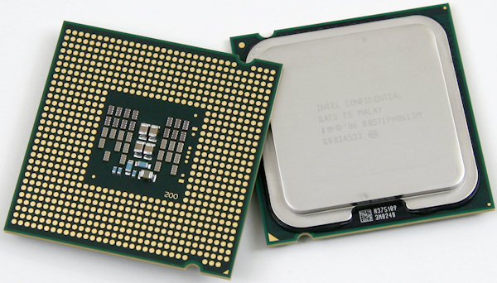
Operating Systems (2015R Regulation)
Hardware:
CPU – Central Processing Unit
Memory
I/O devices
CPU:
It is hardware within a computer which reads instruction to perform specific action. [performing the basic arithmetic, logical, control and input/output operations specified by the instructions]

Slide 5
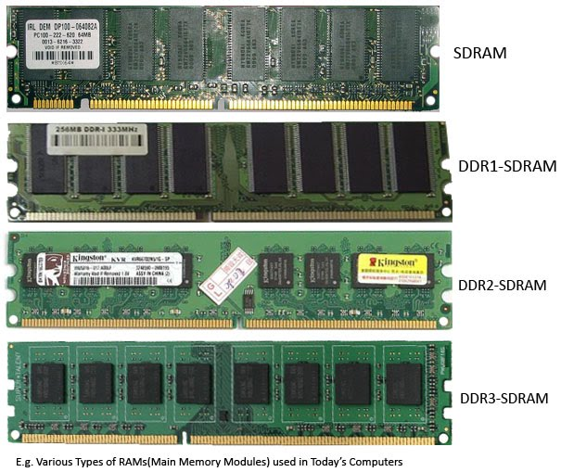
Operating Systems
Memory:
Memory refers to the physical devices used to store programs (sequences of instructions) or data.
Two type of memory:
1. Volatile memory [Primary Memory – Function at high speed]
Volatile memory is computer memory that requires power to maintain the stored information.
Ex: RAM – Random Access Memory

Slide 6
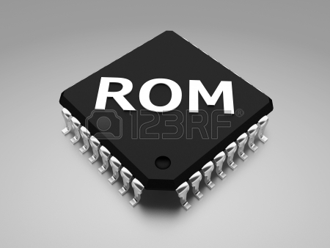
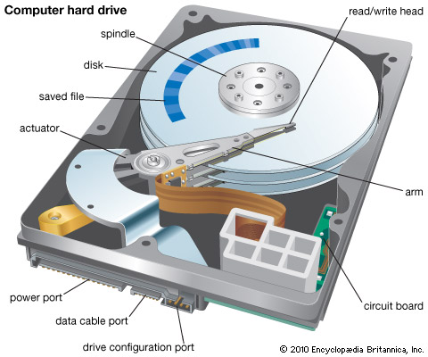
Operating Systems
2. Non- volatile memory [Secondary Memory - slow to access but offer higher memory capacity]
Non-volatile memory is computer memory that can retain the stored information even when not powered.
Ex: ROM – Read Only Memory, hard disk etc...

Slide 7
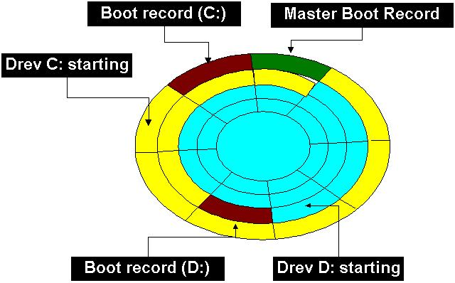
Operating Systems

Slide 8
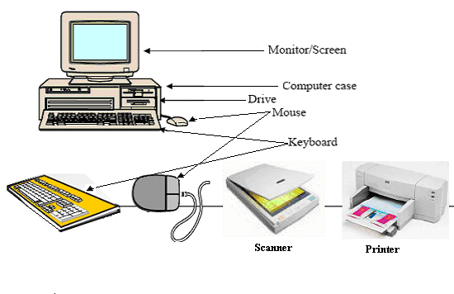
Operating Systems
I/O devices:
Input/output device is a hardware device that accepts inputted information and also has the capability of outputting that information.
Ex: Keyboard, mouse, monitor etc...

Slide 9
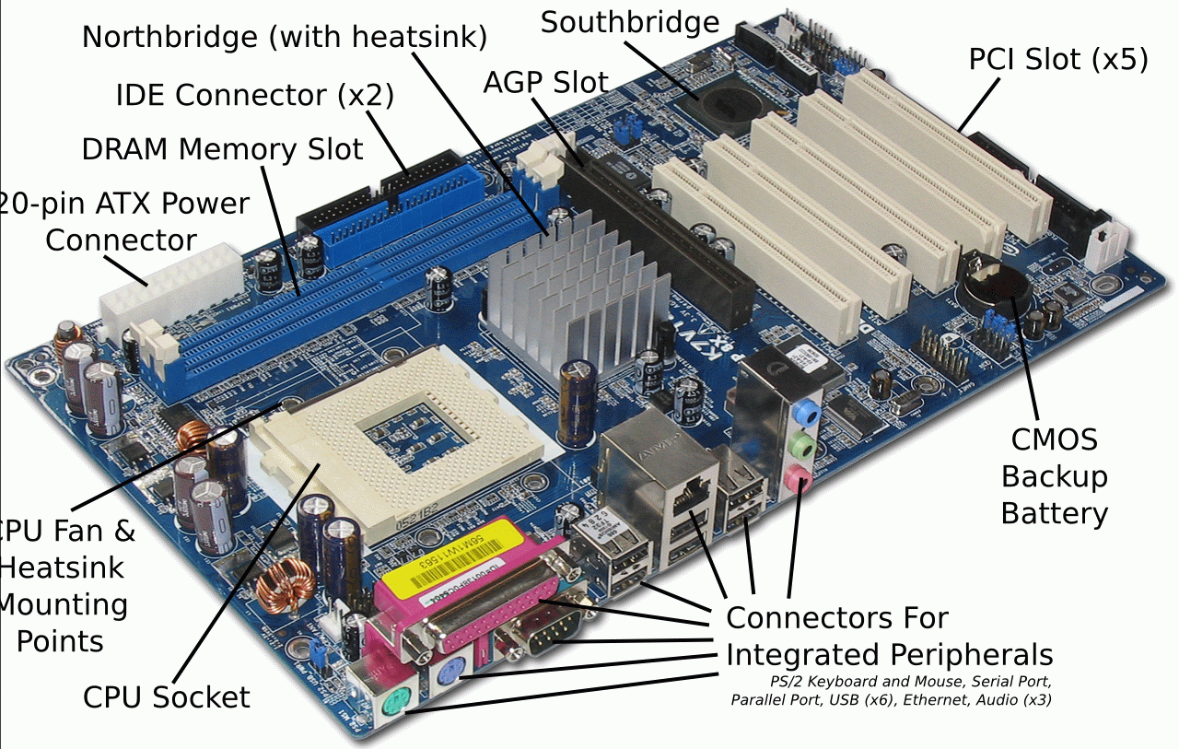
Operating Systems

Slide 10
Operating Systems
Evolution of the Operating System
DOS: Disk Operating Systems
GUI: Graphical User Interface
Multi User
Multi Tasking
Multi Processor
Multi Threading
Real time
Mobile

Slide 11
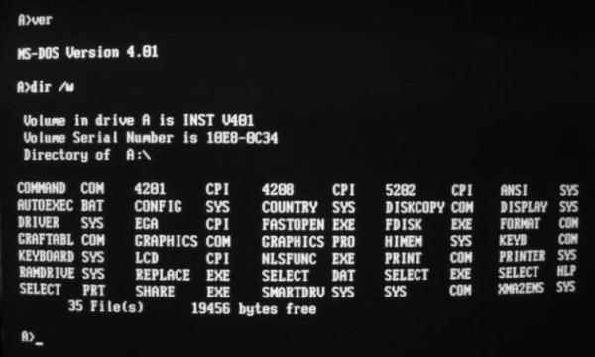
Operating Systems
DOS: Disk Operating Systems
The first personal computer version of DOS, called PC-DOS, was developed for IBM by Bill Gates and his new Microsoft Corporation.
He retained the rights to market a Microsoft version, called MS-DOS(Microsoft disk operating system).

Slide 12
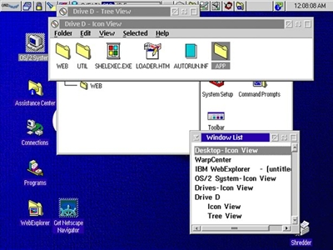
Operating Systems
GUI: Graphical User Interface
GUI is the type of interface that allows users to interact with electronic devices through graphical icons and visual indicators.
A GUI uses windows, icons, and menus to carry out commands, such as opening, deleting, and moving files.
Although many GUI operating systems are through the use of a mouse, the keyboard can also be utilized by using keyboard shortcuts or arrow keys.

Slide 13
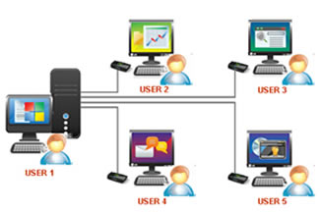
Operating Systems
Multi-user:
Multi user allows two or more users to run programs at the same time.
Some operating systems permit hundreds or even thousands of concurrent users.

Slide 14

Operating Systems
Multi Tasking:
Allows more than one program to run concurrently.

Slide 15

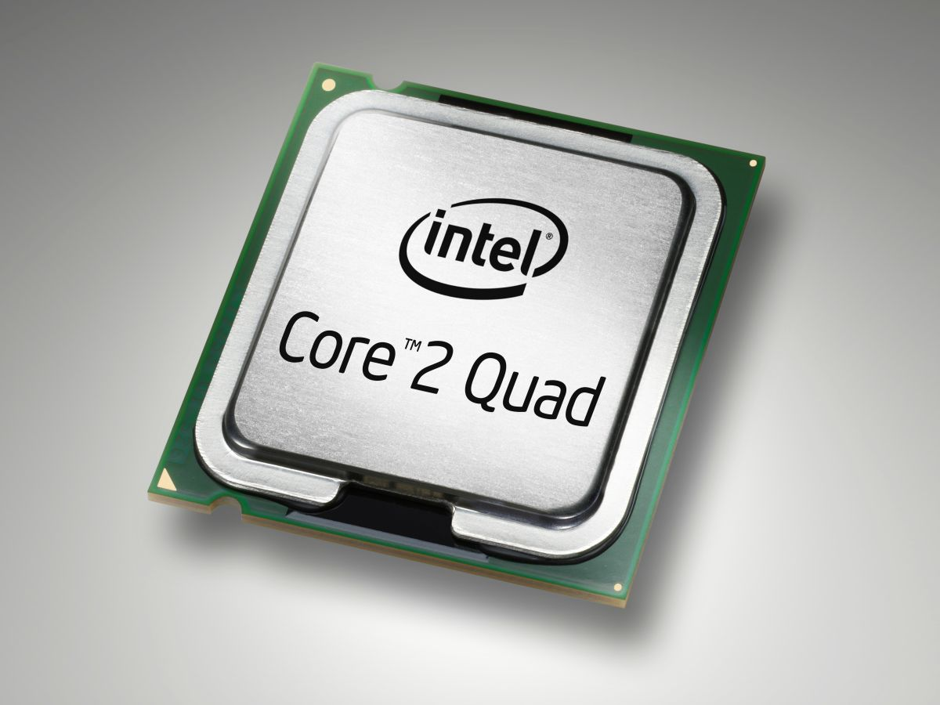
Operating Systems
Multi Processor :
Multiprocessor refers to the use of two or more central processing units (CPU) within a single computer system.

Slide 16
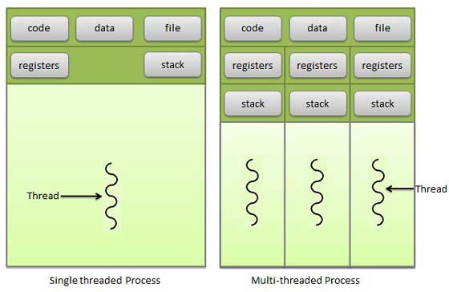
Operating Systems
Multi Threading:
Allows different parts of a single program to run concurrently.
Multithreading extends the idea of multitasking into applications.

Slide 17
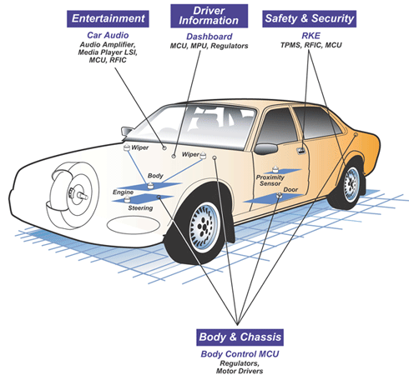
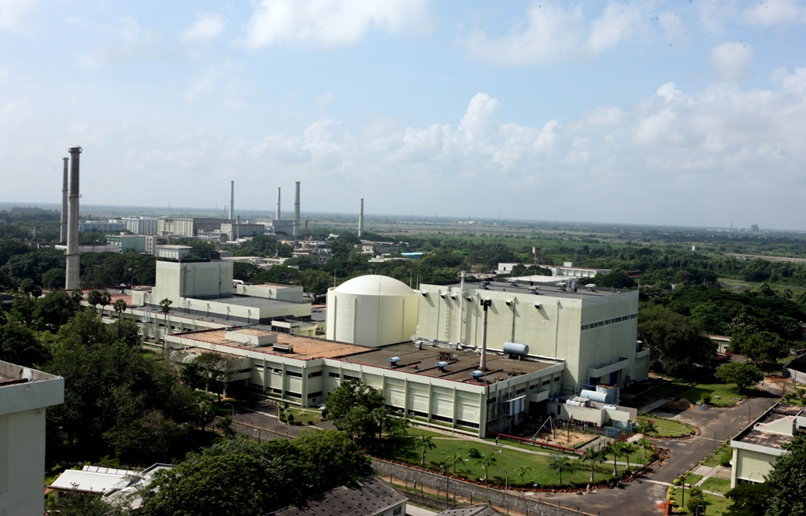
Operating Systems
Real time:
Responds to input instantly.
Ex: Car Engines, Micro ovens, Washing machines…

Slide 18
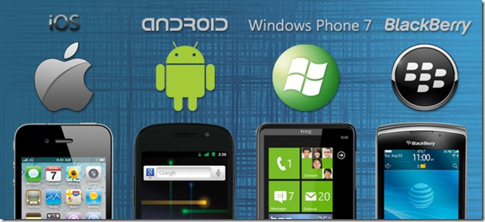
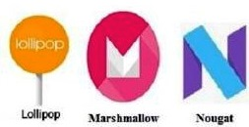
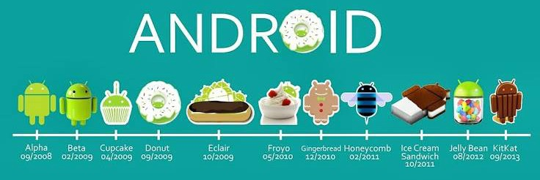


Operating Systems
Mobile:
An operating system that is specifically designed to run on mobile devices such as mobile phones, Smartphone's, PDAs, tablet computers and other handheld devices.

Slide 19
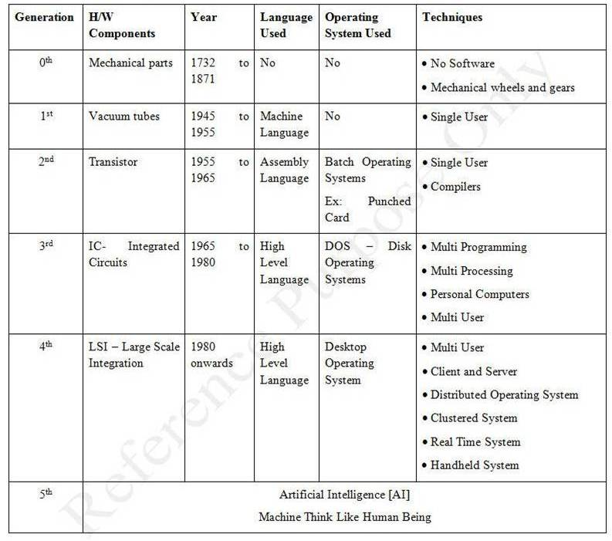
Various Generation of Computer Systems
Operating Systems

Slide 20
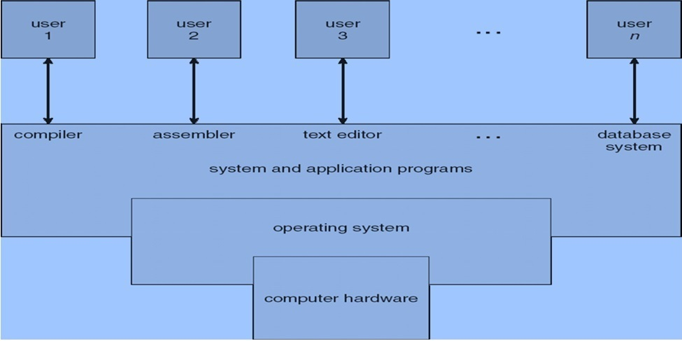
Operating Systems
What operating system Do:
A program that acts as an intermediary between a user of a computer and the computer hardware.
It Provide an environment in which a user can execute program and other application software's.
Objective of Operating System
User View
Easy to Use.
Maximum Resource utilization.
Faster in Execution.
System View
Control Mechanism like I/O devices, Memory, CPU …
Appropriate services of user request.
Effective strategies for resource control. [Resource allocation and reclaim] Multiple resources to be efficiently coordinated during execution of the program.

Slide 21
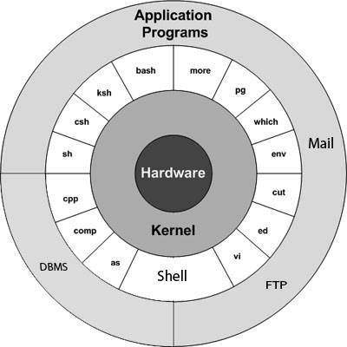
The Structure of the Operating System
Operating Systems
Operating system structure can be classified into many categories:
Monolithic architecture
Layered architecture
Micro kernel architecture so on..
Example:
A layered design of the operating system architecture attempts to achieve robustness by structuring the architecture into layers with different privileges.
Layered architecture

Slide 22
Operating Systems
Operating System Operations:
Modern operating systems are interrupt driven. If there are no processes to execute, OS will sit idle and wait for some event to happen.
Interrupts could be hardware interrupts or software interrupts: The OS is designed to handle both.
A separate code segment is written in the OS to handle different types of interrupts.
These codes are known as interrupt handlers/ interrupt service routine.
A properly designed OS ensures that an illegal program should not harm the execution of other programs. To ensure this, the OS operates in dual mode.
Dual mode of operation
The OS is design in such a way that it is capable of differentiating between the execution of OS code and user defined code. To achieve this OS need two different modes of operations this is thereby controlled by mode bit added to hardware of computer system as shown in Table 4.

Slide 23
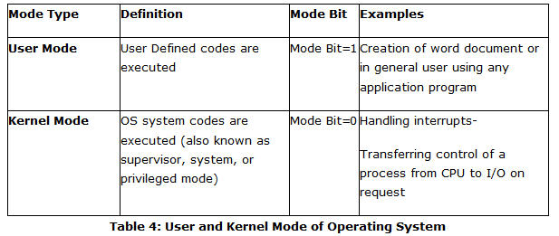
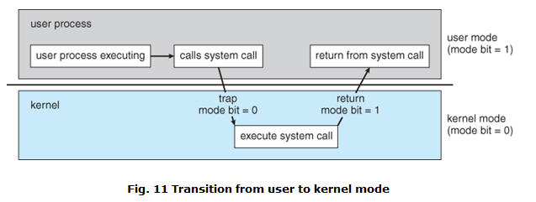
Operating Systems
Transition from User to Kernel mode
When a user application is executing on the computer system OS is working in user mode.
On signal of system call via user application, the OS transits from user mode to kernel mode to service that request as shown in Fig. 11.

Slide 24
Classes of Operating Systems
Operating Systems
Mainframe System
-Batch processing, Multiprogramming, Time-sharing
Desktop Systems
Multiprocessor Systems
Distributed Systems
Clustered Systems
Real time Systems
Handheld Systems
Open Source Operating Systems

Slide 25
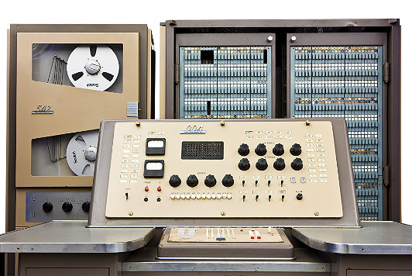
Operating Systems
Mainframe System:
A mainframe computer system is used by large corporate and government organization for processing huge volume of data.
Several manufacturers like IBM, Honeywell, general electronic produced mainframe computers from the late 1950s through the 1970s.
Ex: Banking sector, railway reservation, census, industry and customer statistics, running scientific applications etc…

Slide 26
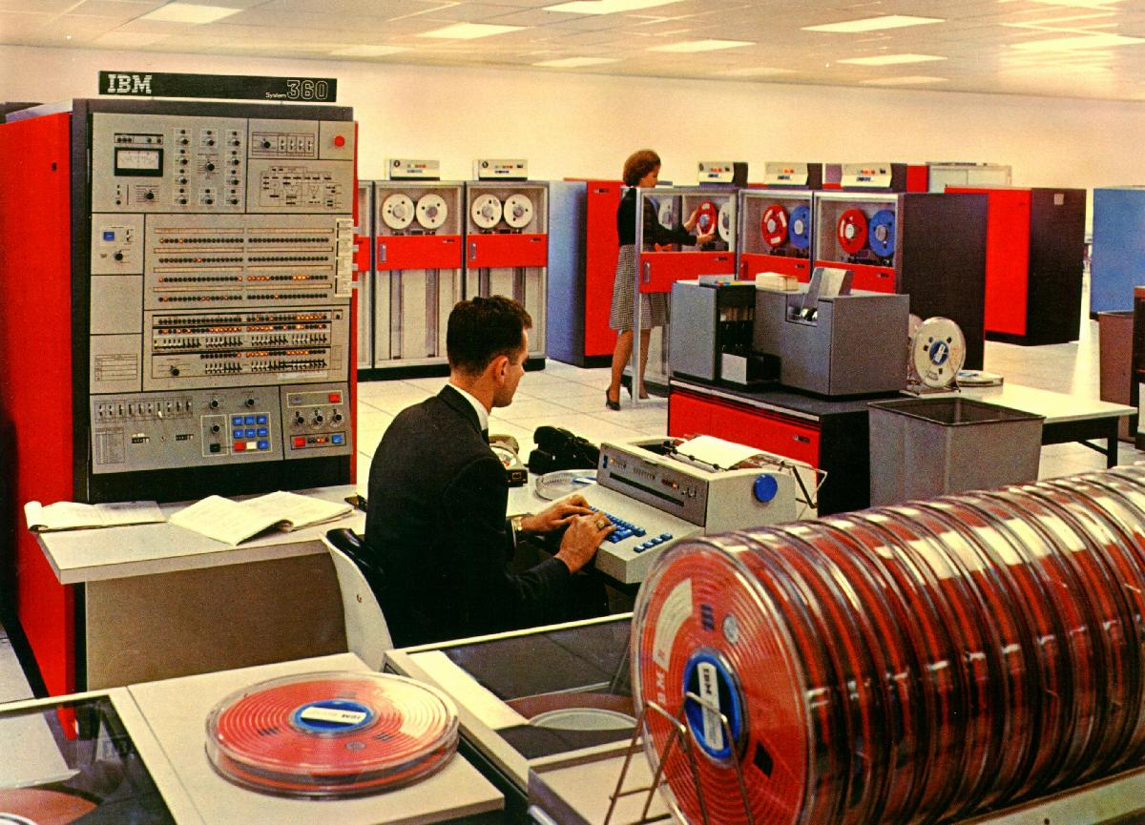
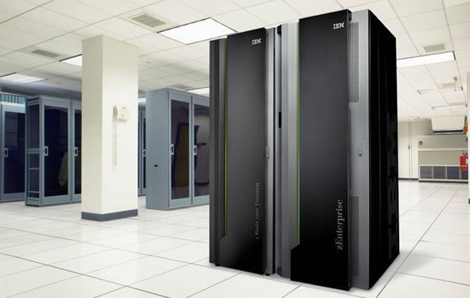
Operating Systems

Slide 27
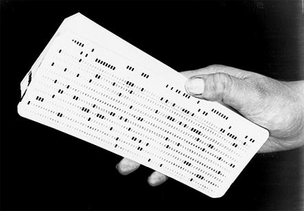
Operating Systems
Mainframe computer system growth starts from
Batch Processing:
Execution of a series of program (jobs) on a computer without manual intervention.
The OS was simple, Its major task was to transfer control from one job to the next.
The job was submitted to the computer operator in form of punch cards. At some time later output appeared.
Common input devices were card readers and tape drives output devices line printers, tape drivers etc..

Slide 28
Operating Systems (2015R Regulation)
Advantages of batch processing:
Once the data process is started, the computer can be left running without supervision.
By keeping high overall rate of utilization, it atomizes the computer, especially an expensive one.
It allows the system to use different priorities for batch and interactive work.
Disadvantages:
Lost interactivity.
Difficult to debug program
Common batch processing usage:
Databases
Batch processing is used for efficient bulk database updates and automated transaction processing.
Ex: online transaction processing (OLTP) applications.
Images
It perform various operations with digital images such as resize, convert, watermark, or otherwise edit image files.
Conversions
Batch processing may also used for converting computer files from one format to another.
For example a batch job may convert proprietary and legacy files to common standard formats for end-user queries and display.

Slide 29
Operating Systems
Multiprogramming:
The operating system interleaves execution of several programs to improve resource utilization and system performance. [Execute number of programs simultaneously by a single processor]
The multi programmed system primarily a batch system, that support multi tasking but not designed as multi user operating system.
Design of Multiprogramming:
The multiprogramming system is significant for its use of a layered structure;
higher layer depends on lower layer.
Advantages:
Efficient memory utilization
Throughput increases
CPU is never idle, so performance increases.

Slide 30
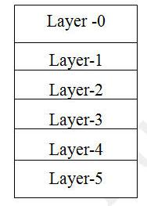
Operating Systems
Layers:
Layer 0 was responsible for the multiprogramming aspects of the operating system. It decided which process was allocated to the CPU was required. (Scheduler)
Layer 1 was concerned with allocating memory to processes. (Pager)
Layer 2 deals with communication between the operating system and the console.
Layer 3 managed all I/O between the devices attached to the computer.
Layer 4 consisted of user programs. [ They handled the compilation, execution, and printing of users' programs. When finished, they passed control back to the schedule queue, which was priority-based, favoring recently started processes and ones that blocked because of I/O]
Layer 5 was the user.

Slide 31
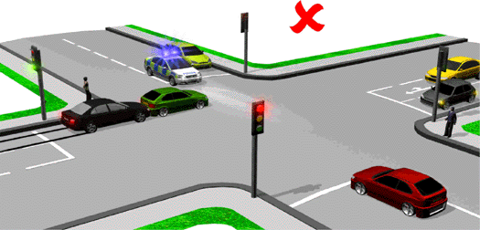
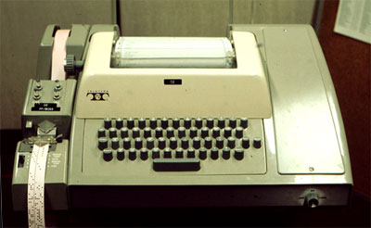
Operating Systems
Time-sharing:
Time shared systems is the first operating system that support virtual addressing, it provide the time sharing feature.
Batch system and multiprogramming system provide system resources like CPU, Memory, Peripheral devices etc.…
Time shared systems is a logical extension of multiprogramming, by allowing a large number of users to interact concurrently with a single computer, the CPU time is divided into equal slots:
Slots are assigned to all the users connected to the systems.
(first come first basis and the turn comes in round robin)
User can use the system only for the specified time slot.
Generally time sharing system are used when a powerful server computers serves several client computers

Slide 32
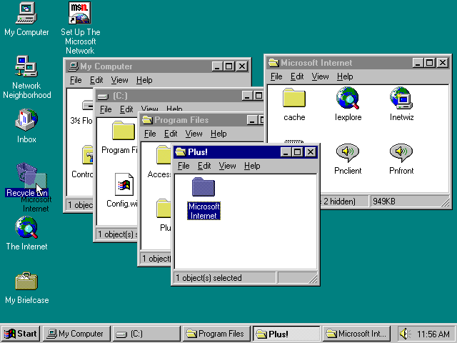
Operating Systems
Desktop Systems:
A personal computer (PC) is a general-purpose computer, whose size, capabilities and original sale price makes it useful for individuals, and which is intended to be operated directly by an end-user with no intervening computer operator.
Software applications for most personal computers include, but are not limited to, word processing, spreadsheets, databases, Web browsers and e-mail clients, digital media playback, games and special-purpose software applications.
Advantage: User convenience and responsiveness
Example
Microsoft – DOS (Disk Operating System), windows CE, windows workgroup, windows NT, windows 95, windows 98…..
Sun Microsystems – SunOS (Solaris)
Unix like OS (Linux)
Micro, mini and super computers also developed

Slide 33
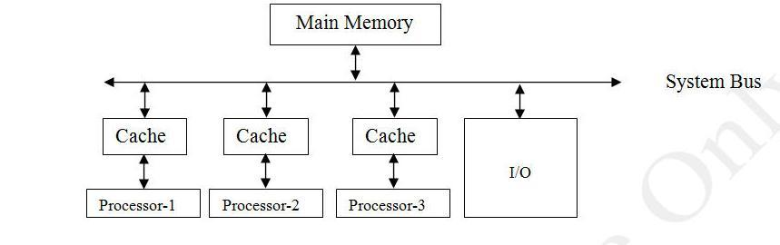
Operating Systems
Multiprocessor Systems:
The Multiprocessor systems have more than one processor in close communication.
They share the computer bus, system clock, I/O devices.
In multiprogramming system, it is possible for more than one processes to run in parallel.
Main goal of the multiprocessor system to increase speed of execution of the system.

Slide 34
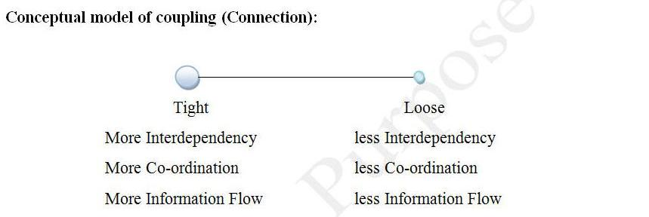
Operating Systems
Processor coupling:
Tightly coupled:
Tightly coupled systems are a group of machines that are largely depends on each other.
Ex: Distributed systems
Loosely coupled:
Loosely coupled systems are a group of machines which can independent of each other.
Ex: Network operating systems

Slide 35
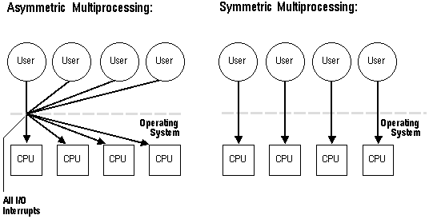
Operating Systems
Multiprocessor systems are two types:
Symmetric multiprocessing
Symmetric multiprocessing, each processor runs an identical copy of the OS and they communicate with one another as needed.
Asymmetric multiprocessing
Asymmetric multiprocessing, each processor is assigned a specific task. It uses master-slave relationship.
A master processor controls the system. The master processor schedules and allocates work to slave processors.
Advantages:
Increased throughput
Increase reliability: Job can be distributed properly among several processors than the failure of one processor will not affect the entire system. Only slow down the system.

Slide 36

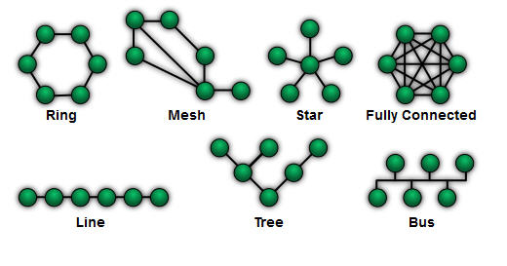
Operating Systems
Distributed Systems:
A Distributed system consists of a collection of autonomous computers, connected through a network and distribute middleware (Provide general purpose services), which enable computer to co-ordinate their activities and to share the resources of the system.
Example: The internet – Global access to everybody
Networks are typecast based on the distance between their nodes:
LAN – Local area network (Exists within a room, a floor or a building)
WAN – Wide area network (Exists between buildings)
MAN – Metropolitan –area network (Link buildings within a city)
Small-area network – Bluetooth device communicate over a short distance (Several feet)

Slide 37
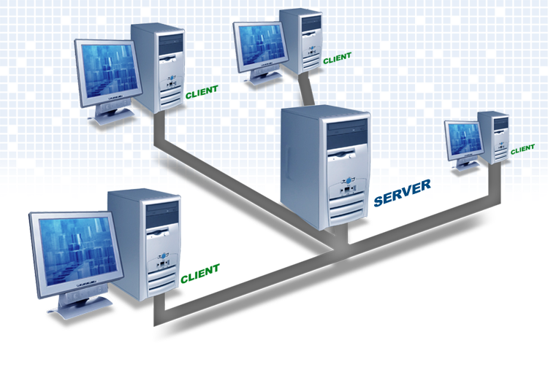
Operating Systems
Client - Server Systems:
The client–server computing is a distributed application structure that partitions tasks or workloads between the providers of a resource or service, called servers, and service requesters, called clients.
The client process always initiates a connection to the server, while the server process always waits for requests from any client.
Server systems can be broadly categorized:
Compute-server systems
Clients can send request to perform a computation, server executes and send back results to client.
File-server systems
Clients can create, update, read and delete files.
Advantages:
Resource sharing
Resource utilization across the boundary
Reliability
Availability of resources and services despite failures.
Communication
Provide communication between remote entities.

Slide 38
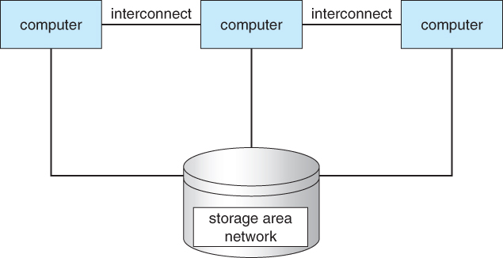
Operating Systems
Clustered systems:
Like multiprocessor systems, Clustered systems consists of a set of loosely or tightly connected computers that work together.
Cluster cannot allow multiple nodes to access the same data unless a Distributed Lock Manager (DLM).
Asymmetric clustering:
One machine is in hot standby mode (Monitoring activity)while other is running the applications.
Symmetric clustering:
Two or more hosts are running applications, and they are monitoring each other.

Slide 39
Operating Systems
Real time systems:
A real-time system is one that must process information and produce a response within a specified time, else risk severe consequences, including failure. (Well defined fixed time constraints)
Examples:
ABS, aircraft control, ticket reservation system at airport, over-temperature monitor in nuclear power station, oven temperature controller, fuel injection system, scientific equipments etc..
Real time systems comes into two flavors:
Hard real time system
The system guarantees that critical tasks be completed on time.
The preemption period should be very less .
Ex: Rocket launching
Soft real time system
The task and its deadline is manageable but we should met the condition most of the all the time.
The preemption period for this can be more.
Ex: camera and washing machine etc..

Slide 40

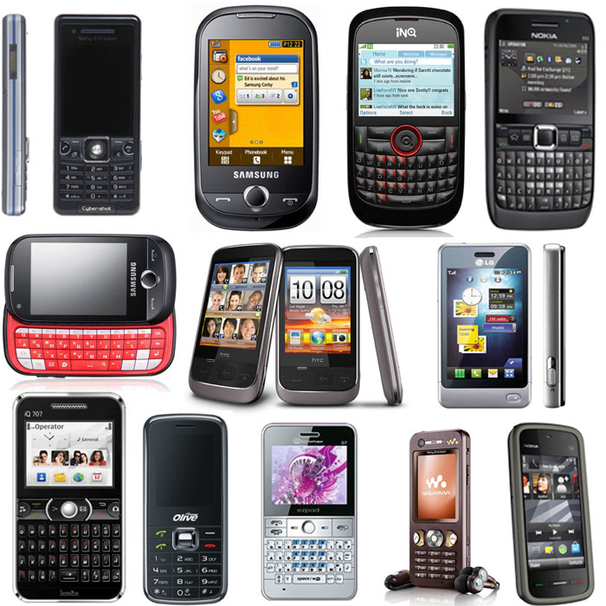
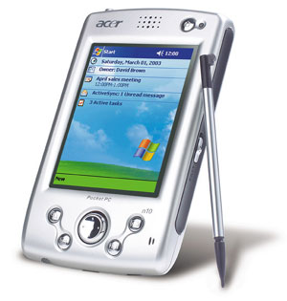
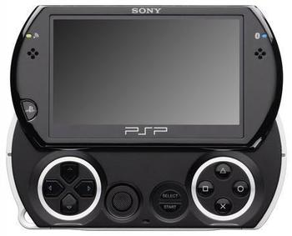
Operating Systems
Handheld Systems:
Handheld operating systems are designed to run on machines that have lower speed processors, small display screens and less memory.
Ex: Personal Digital Assistants (PDAs), Cellular telephones et..
Major competitors are :
Palm corporation with their Palm OS
Microsoft with Pocket PC.
Nokia with Symbian OS
Google Android etc…

Slide 41
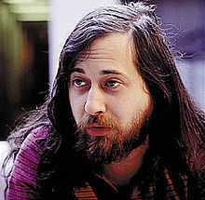
Operating Systems
Open Source Systems:
Open source as a development model promotes universal access via a free license to a product's design, blueprint, software etc..
Universal redistribution for subsequent improvements to it by anyone.
Goal of obtaining and guaranteeing certain freedoms for software users:
Freedom to run the software, to study and change the software, and to redistribute copies with or without changes.
Started by Free Software Foundation(FSF), which has “Copy left” GNU Public License (GPL)
Richard Stallman, founder of the GNU Project
and the free software movement, in or before 2002.
Non-proprietary:
Ex: Unix-like , Linux, Android etc..

Slide 42
Operating System Components

Slide 43
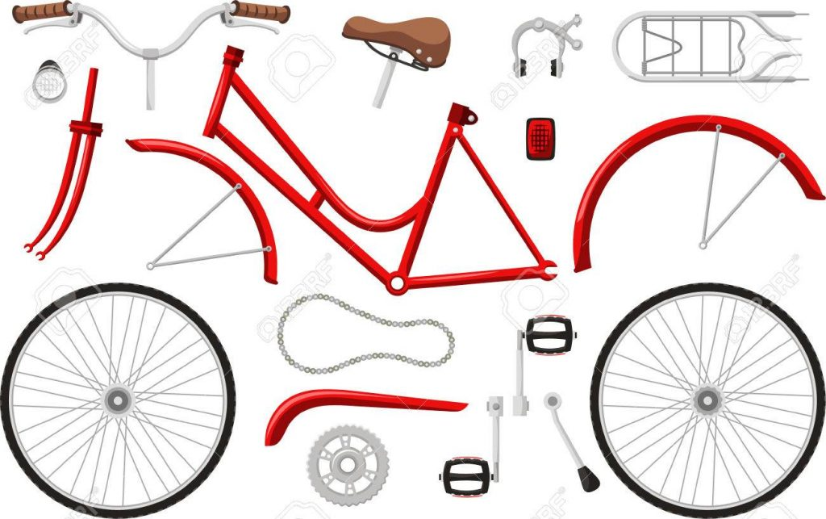
Bicycle - Components

Slide 44
Operating Systems
Operating System Components and Services
Operating System Components | Operating System Services
Process Management | User Interface
Memory Management | Program Execution
Storage Management | I/O Operations
I/O System Management | File System Manipulation
 | Communication
 | Error Detection
OS with Multiple User | OS with Multiple User
Network Management | Resource Allocation
 | Accounting
Protection and security | Protection and Security

Slide 45
Operating Systems
Process Management:
A process is an execution of a program, during execution of processes they needs certain resources like CPU time, memory, files and I/O devices etc..
System consists of collection of processes, some of which are OS processes, user processes, network process etc..
Ex: Compilers, word-processing, sending out to the printer etc..
The Operating system is responsible for the following activities in connection with process management:
Creation and deletion of both user and system processes.
Suspending and resuming processes.
Providing mechanism for process synchronization.
Providing mechanism for process communication.
Providing mechanism for deadlock handling.

Slide 46
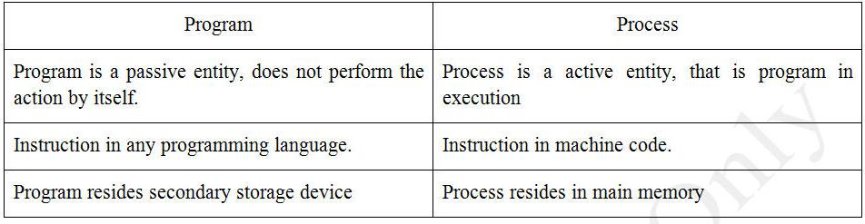


Operating Systems
Program vs Process

Slide 47
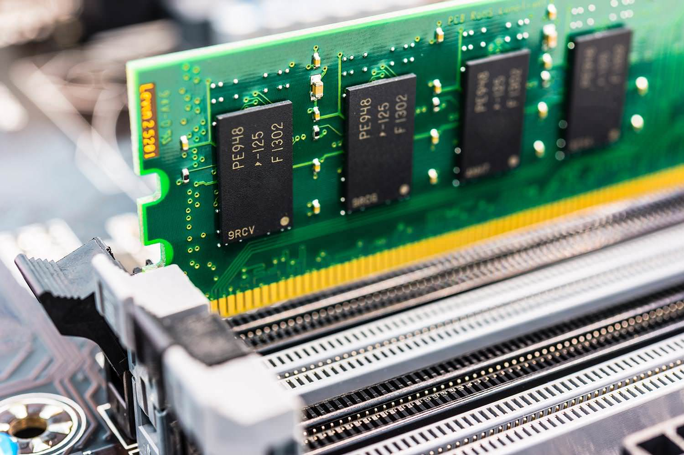
Operating Systems
Memory management :
Main memory management [RAM]
Main memory is a very large array of bytes, each byte has its own address and quickly accessible data shared by CPU and I/O devices. [Main memory directly accessed by CPU]
Data must first transferred to main memory by CPU generated I/O calls. Equivalently, The instructions must be in memory for the CPU executes them.
The processor reads the instruction from main memory during instruction fetch cycle, both read and writes data from main memory during data fetch cycle.
The Operating system is responsible for the following activities in connection with Main-memory management:
Keeping track of which parts of memory currently being used.
Deciding which processes are to be loaded into memory.
Allocating and de-allocating memory space.

Slide 48
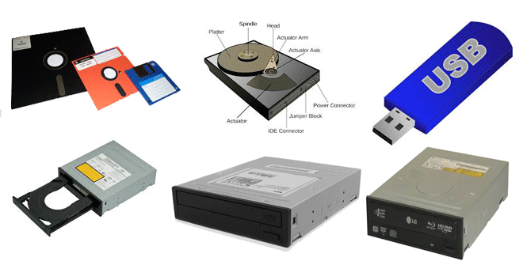
Operating Systems
Storage Management:
File management
File is a collection of bytes stored in secondary device. Files are normally organized into directories.
Files are easy to access and provide permission to multiple users. [ Read, Write, Append, Delete etc…]
The Operating system is responsible for the following activities in connection with file management:
Creating and deleting files.
Creating and deleting directories.
Supporting primitives for manipulating files and directories.
Mapping files into secondary storage device.
Backing up files on stable storage media.
Transmission of files between main memory and secondary memory.

Slide 49
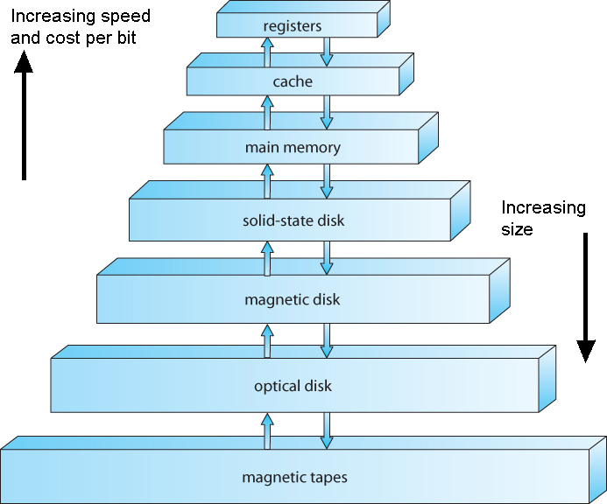
Operating Systems
Secondary storage management [Hard disk]
During execution period data and program must be in main memory.
Main memory is too small to accommodate all data and program is not possible and also power is lost data also lost. So, computer system provide secondary storage device to backup main memory.
Most of the programs like compilers, assemblers, text editors are stored on disk until loaded into memory.
Storage Device Hierarchy:

Slide 50
Operating Systems
Free-Space Management :
To reuse the space from deleted files for new files. To keep track of free disk space.
Storage Allocation:
The main idea behind allocation is effective utilization of file space and fast access of the files.
There are three types of allocation:
contiguous allocation
linked allocation
indexed allocation
Disk Scheduling:
In Multi-programming environment we can Execute Many Programs at a Time. So
Controlling and providing the Memory to all the Processes Operating System uses the Concept of Disk Scheduling.
CPU uses the following the Scheduling Techniques:
1.FCFS (First Come First Serve)
2.SSTF (Shortest Seek Time First)
3.SCAN
4.C-SCAN
5.LOOK

Slide 51
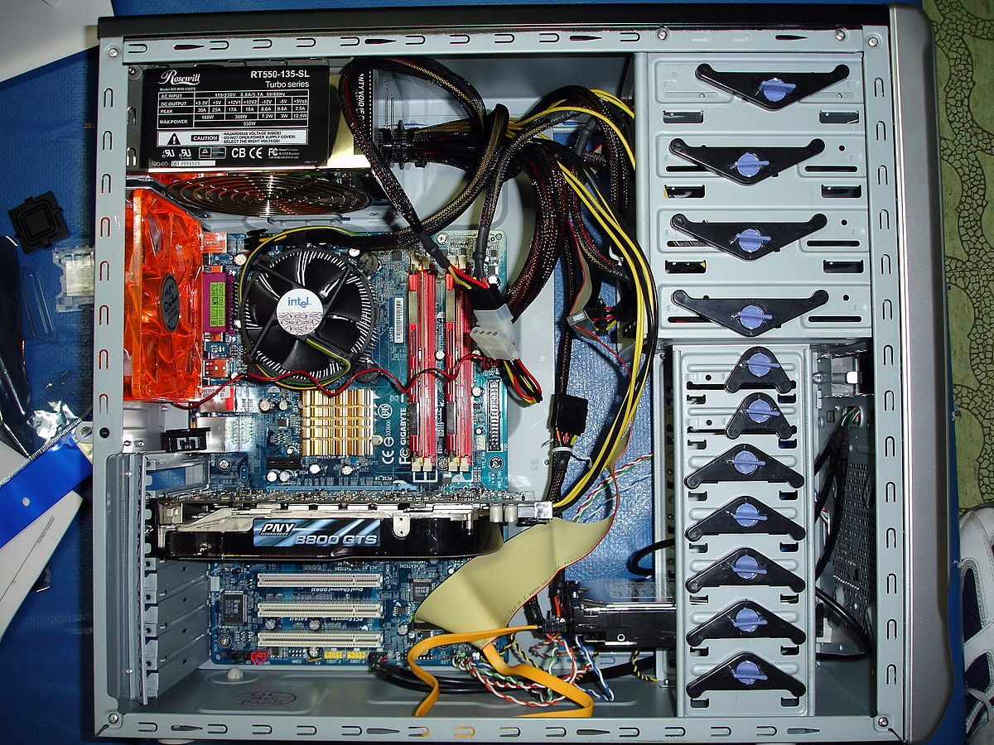
Operating Systems
I/O system management:
One of the purposes of an operating system is to hide the specific H/W devices from the user.
Each I/O devices has a device handler that resides in a separate process associated with that device called as sub system.
The I/O Sub system consists of:
Memory management components that includes buffering, caching, spooling.
Device driver interface.
Driver for specific H/W devices.

Slide 52

Operating Systems
Operating system with multiple users:
Networking
Networking enables computer users to share resources and speed up computations.
Ex: Distributed system.
The Operating system is responsible for the following activities in connection with Networking:
Types of network Ex: LAN, WAN, MAN etc…
Topology of network Ex: Ring, Star, Bus, Line etc…
Physical medium
Communication protocol
Routing protocol

Slide 53

Operating Systems
Protection and Security
Modern computer system support many users and allow the concurrent execution of multiple processes.
It is necessary that the information must be protected from unauthorized users or processors.
Protection is mechanism for controlling the access of program or process or resources defined by the system and protection can improve reliability.
The Operating system is responsible for the following activities in connection with protection system:
Providing user access
Privileged access

Slide 54
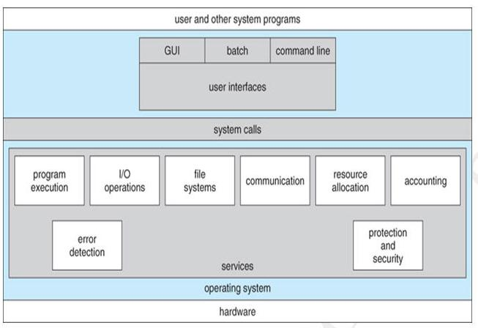
Operating Systems
A view of operating system services:

Slide 55
Operating Systems
Program execution
Operating system loads a program into memory and executes the program.
I/O operations
A running program may require I/O. This I/O may involve a file or an I/O device.
The user cannot control the I/O devices directly, so operating system provides the required I/O.
File system manipulation
Program needs to read and write a file.
The operating system gives the permission to the program for operation on file.
Communication
Processes may exchange information, on the same computer or between computers over a network
Ex: Distributed system
Communication may be implemented by two methods:
Shared memory
Message passing
Error detection
Error may occur in CPU or I/O devices or memory.
The operating system constantly needs to be aware of possible errors and it should take the appropriate action to correct and consistent computing.

Slide 56
Operating Systems
Operating system with multiple users:
Resource allocation
If there is more than one user or jobs running at the same time, then resources must be allocated to each of them, operating system manages different types of resources like memory, CPU cycles, I/O devices etc…
Accounting
The accounting data (logs) may be used for statistics and also used to improve system efficiency.
Protection
Protection involves ensuring that all access to system resources controlled.
Security starts with each user having to authenticate to the system, usually by means of a password.
I/O devices also protected from invalid access attempts.

Slide 57
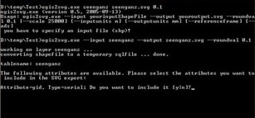
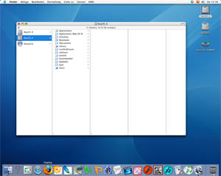
Operating Systems
User and Operating system Interface:
In computer science and human-computer interaction, the user interface (of a computer program) refers to the graphical, textual and auditory information the program presents to the user.
The user employs several control sequences (such as keystrokes with the computer keyboard, movements of the computer mouse, or selections with the touchscreen) to control the program.
There exist several types of user interfaces:
Command-Line Interface (CLI): A command-line interface , is a means of interacting with a computer program where the user (or client) issues commands to the program in the form of successive lines of text (command lines).
Graphical User Interface (GUI): The graphical user interface (GUI ) is a type of user interface that allows users to interact with electronic devices through graphical icons and visual indicators such as secondary notation, instead of text-based user interfaces, typed command labels or text navigation.

Slide 58
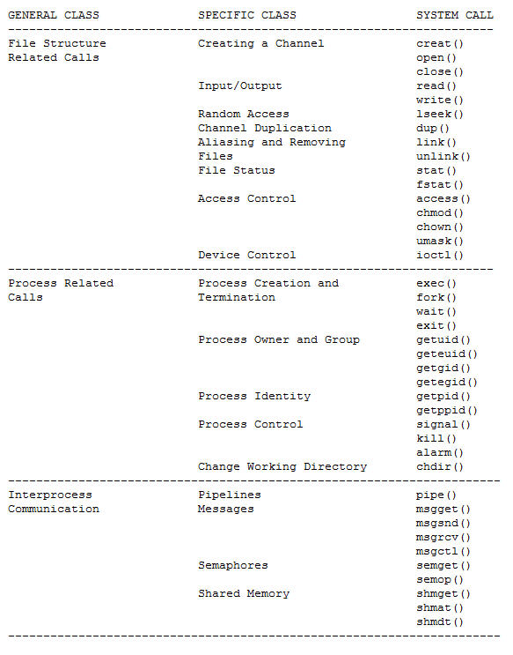
Operating Systems
System calls:
System calls provide the interface between process and operating system.
The system calls are functions used in the kernel itself.
The system call appears as a normal C function call.
Example of system calls are used:

Slide 59
Operating Systems
UNIT -1
Fundamentals of Computer Systems | Evaluation of Operating Systems | Different Classes of Operating Systems | Operating System Components | Operating System Services
User | DOS | Mainframe Systems | Process Management | User Interface
Application and System Program | GUI | Desktop Systems |  | Program Execution
 |  |  |  | I/O Operations
Operating System | Multi User | Multiprocessor Systems | Memory Management | File System Manipulation
Hardware | Multi Processor | Distributed Systems | Storage Management | Communication
 | Multi Tasking | Clustered Systems | I/O Systems Management | Error Detection
 | Multi Threading | Real Time Systems | OS With Multiple User:
 | Real time | Handheld Systems | Networking | Resource Allocation
 | Mobile |  | Protection & Security | Accounting
 |  | Open Source System
 |  |  |  | Protection & Security

